Slide 1
Analysis for
Graph-based SLAM algorithms
under g2o
16833 Project Final Presentation
2021/05/05
Tianxiang Lin
Ben Zhou
Qishun Yu
Jiayin Xia
Kerou Zhang

Slide 2
Project Description
Tools for robustness test of pose graph optimization
Robust Kernels
Optimization Algorithms: GN/LM/DL
Datasets
Experiments
Poor initialization
Loop closure outliers
Notes:
http://ir.ia.ac.cn/bitstream/173211/19422/1/Comparison%20of%20methods%20to%20efficient%20graph%20SLAM%20under%20general%20optimization%20framework.pdf

Slide 3
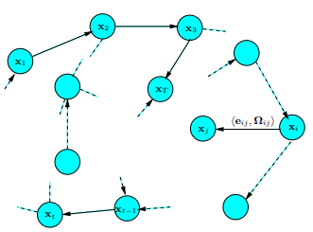

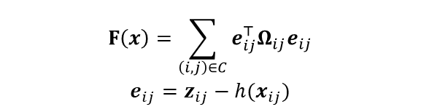
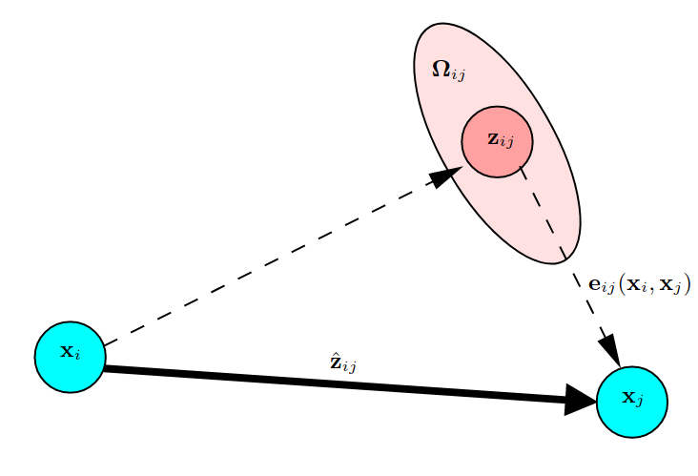

Graph-based SLAM
Goal
Objective Function
A pose-graph representation of a SLAM process*
Solving
Aspects of an edge connecting vertices*
* R. Kuemmerle, G. Grisetti, H. Strasdat, K. Konolige, W. Burgard, "g2o: A General Framework for Graph Optimization", In Proceedings of the IEEE International Conference on Robotics and Automation (ICRA), Shanghai, China, pp. 3607-3613, 2011.
Notes:
The optimization problem contains three principal elements: objective function, optimized variables, and constraints. Most optimization problems are too complex to directly derive the analytic form of the objective function's derivatives. Therefore, we solve optimization problems iteratively most of the time, for example, Gauss-Newton(GN) and Levenberg-Marquardt (LM).
Figure 6. Let x = (x1, . . . , xT ) T be a vector of parameters, where xi describes the pose of node i. Let zij and Ωij be respectively the mean and the information matrix of a virtual measurement between the node i and the node j.

Slide 4
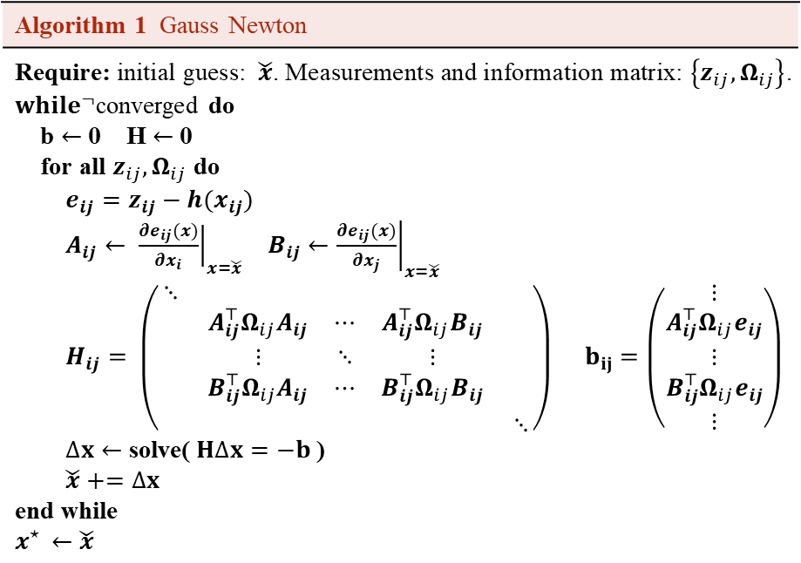
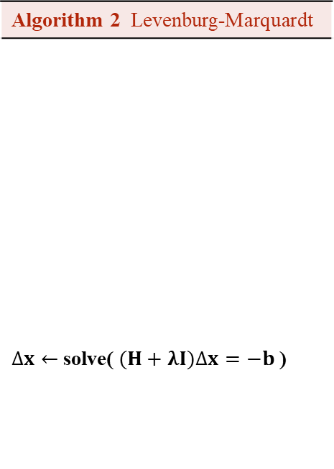
Optimization Algorithms
Algorithm 1 Gauss Newton
Require: initial guess:$\check{x}$. Measurements and information matrix: $\left\{z_{ij}, Ω_{ij}\right\}$. ${while}^{¬}$converged do b $←$ 0 H $←$ 0 for all $z_{ij}, Ω_{ij}$ do $e_{ij}=z_{ij}−h(x_{ij})$ $A_{ij}← {\left.\frac{∂e_{ij}(x)}{∂x_{i}}\right|}_{x=\check{x}}$ $B_{ij}←{\left.\frac{∂e_{ij}(x)}{∂x_{j}}\right|}_{x=\check{x}}$ $H_{ij}= \left(\begin{matrix}⋱ & & \\ & \begin{matrix}A_{ij}^{⊤}Ω_{ij}A_{ij} & ⋯ & A_{ij}^{⊤}Ω_{ij}B_{ij} \\ ⋮ & ⋱ & ⋮ \\ B_{ij}^{⊤}Ω_{ij}A_{ij} & ⋯ & B_{ij}^{⊤}Ω_{ij}B_{ij}\end{matrix} & \\ & & ⋱\end{matrix}\right) b_{ij}=\left(\begin{matrix}⋮ \\ \begin{matrix}A_{ij}^{⊤}Ω_{ij}e_{ij} \\ ⋮ \\ B_{ij}^{⊤}Ω_{ij}e_{ij}\end{matrix} \\ ⋮\end{matrix}\right)$ $∆x←$ solve($H∆x=−b$) $\check{x}+=∆x$ end while $$x^{⋆ }←\check{x}$$
Algorithm 2 Levenburg-Marquardt
$∆x←$ solve($(H+λI)∆x=−b$)
⁝
⁝
⁝

Slide 5
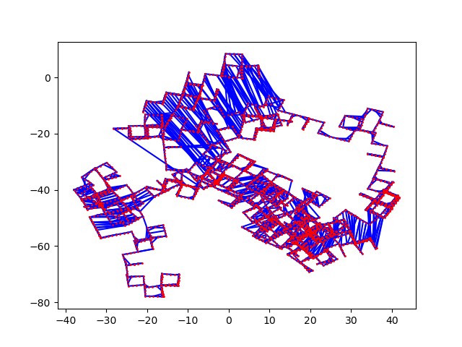
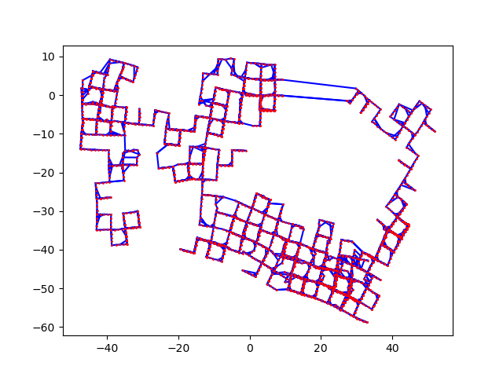
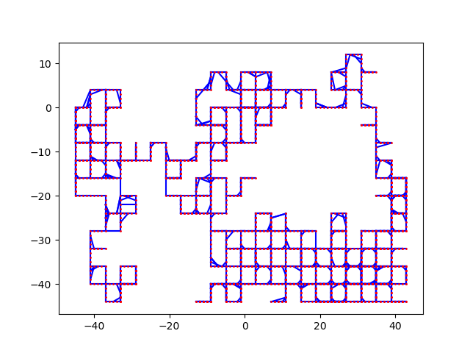
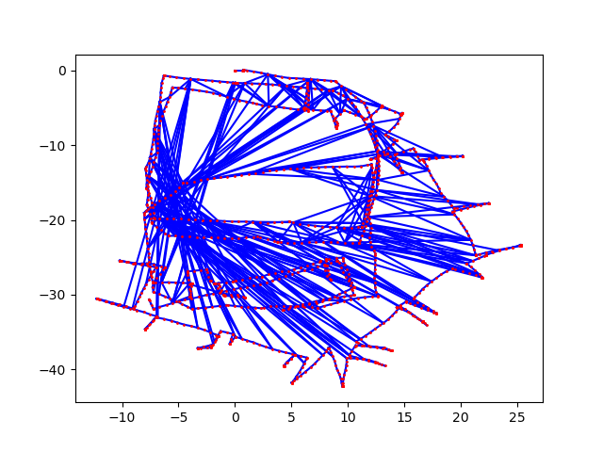
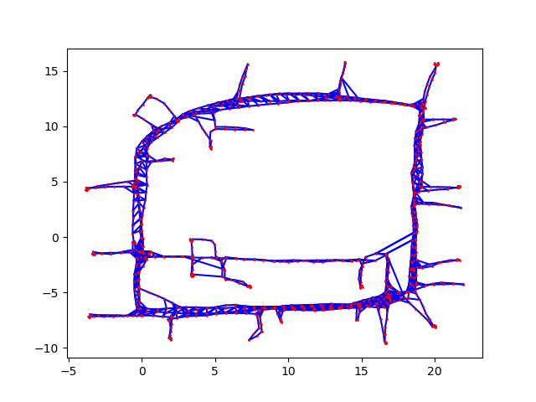
Datasets
Manhattan3500 (synthetic dataset)
Original dataset was by Olson
Second version included in g2o
Ground truth
Quality of the initial estimate: g2o closer to the ground truth
Intel Research Lab (real-world dataset)
Intel by Luca, obtained by processing the raw measurements from wheel odometry and laser range finder
Pseudo ground truth, estimation result provided in g2o
M3500 Olson
M3500 g2o
M3500 gt
Intel luca
Intel gt
Notes:
We use publicly available datasets, the Manhattan3500 and Intel Research Lab

Slide 6
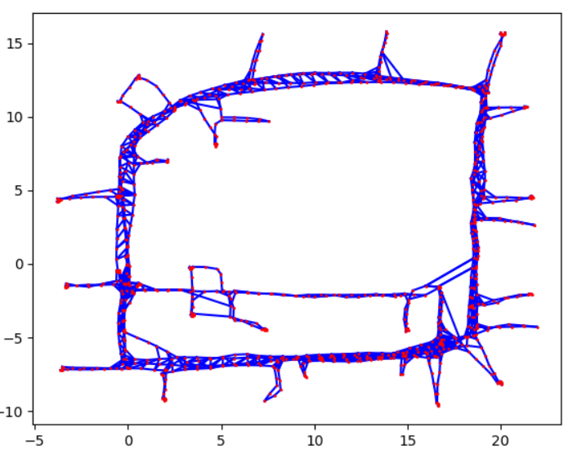
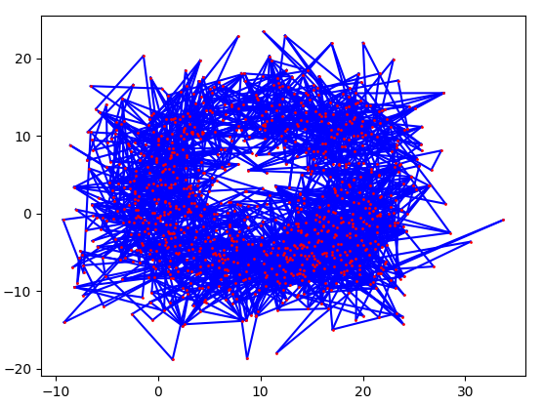
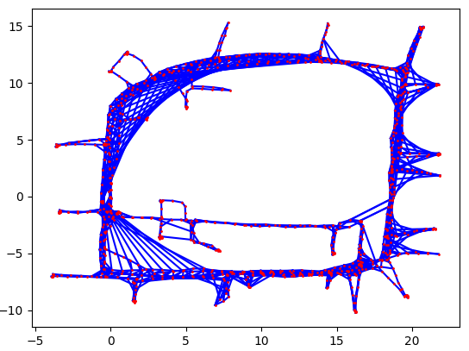
Experiments: Poor initialization & Loop closure outliers
Poor initialization: Add random values on ground truth to simulate bad initial guesses
Loop Closure Outliers: Modify edge values to simulate incorrect loop closure constraints

Slide 7
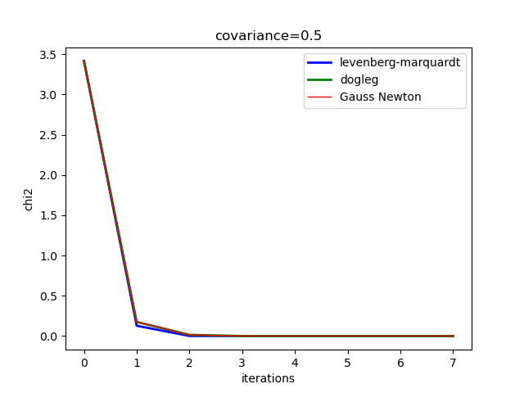
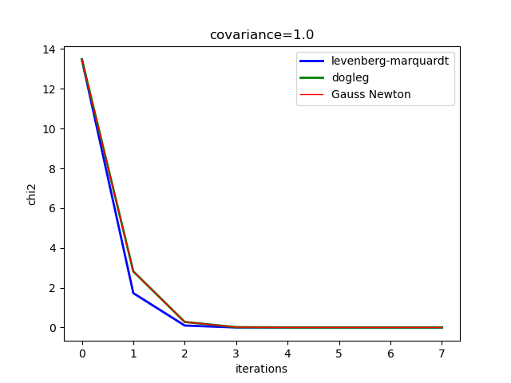
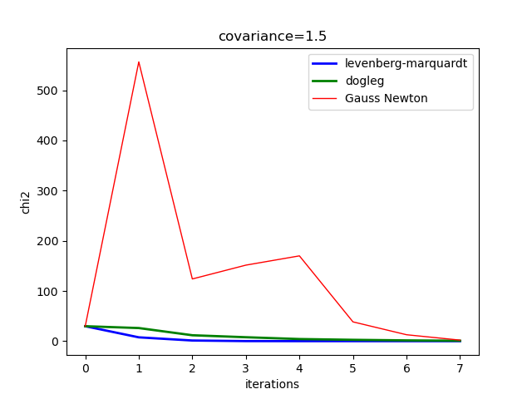
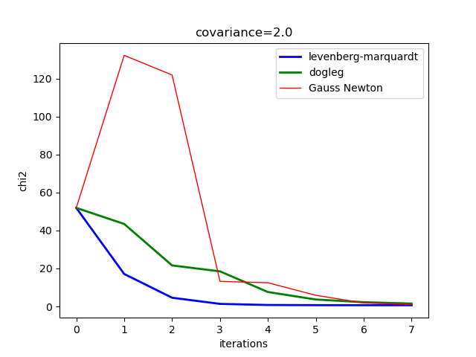
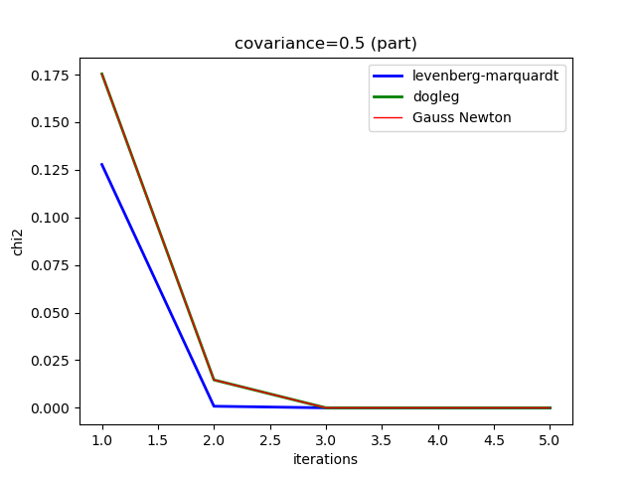
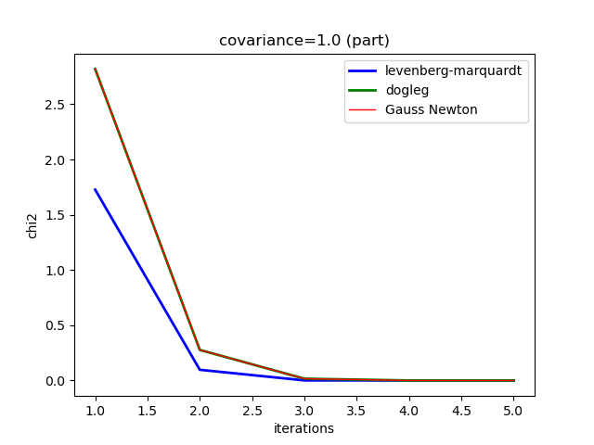
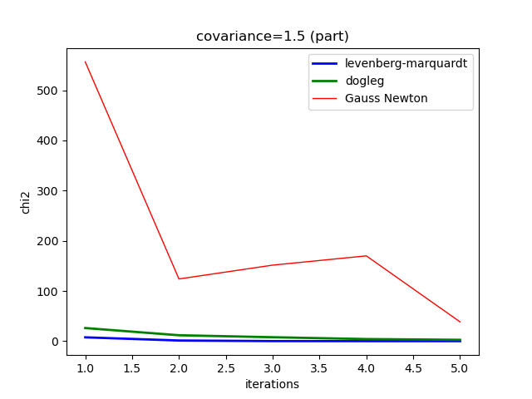
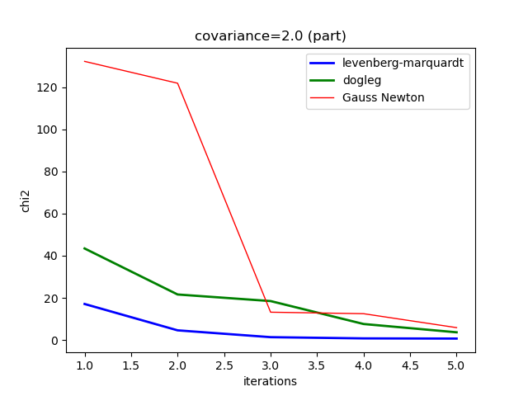
Experiment 1: How do different noise and poor initial estimate affect optimization algorithms?
Notes:
GN vs LM vs DL

Slide 8
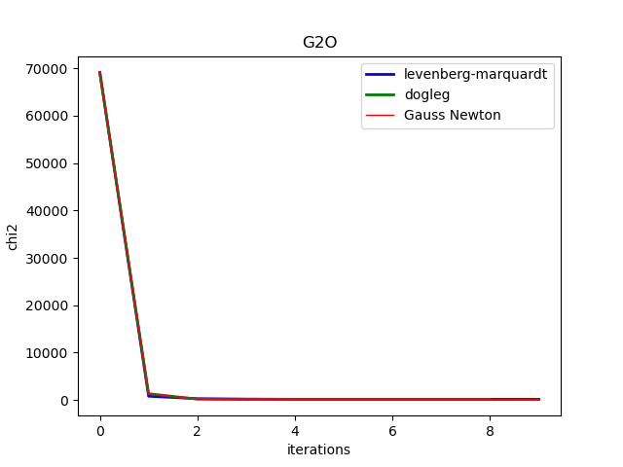
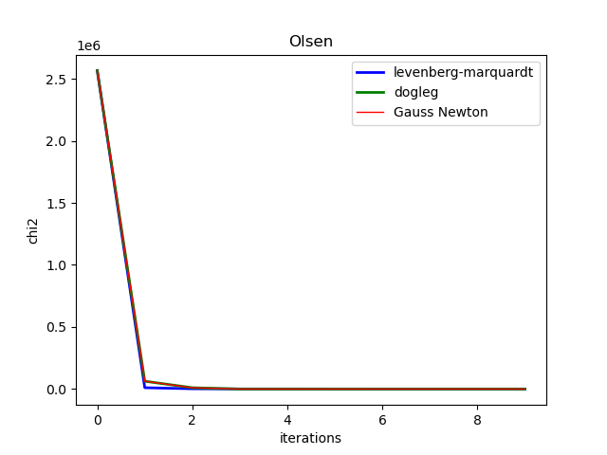
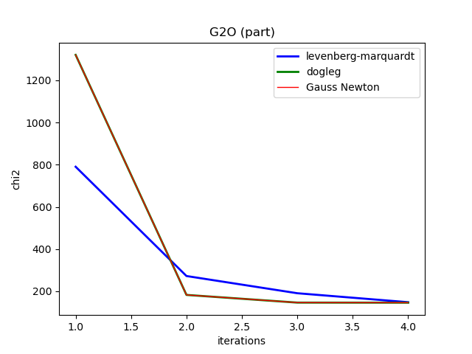
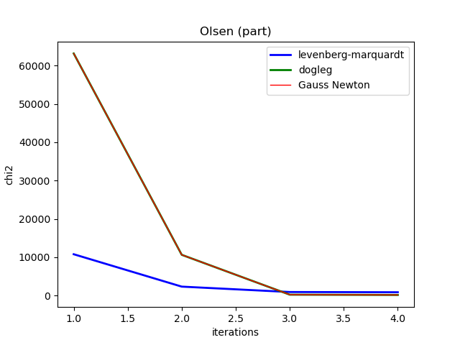
Experiment 1: How do different noise and poor initial estimate affect optimization algorithms?
Gauss-Newton has the quickest convergent speed but may show sawtooth-like behavior.
Dog-leg sometimes uses GN for convergence, so their curves are similar.
Chi2 cannot become zero when initial guesses are bad.
Notes:
GN vs LM vs DL

Slide 9
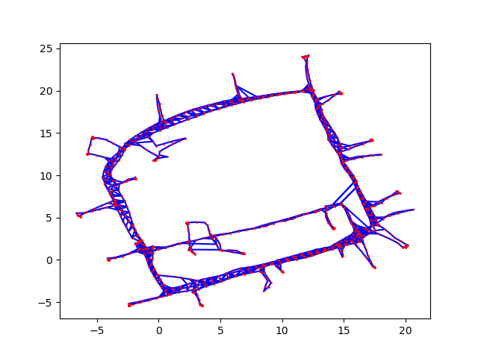
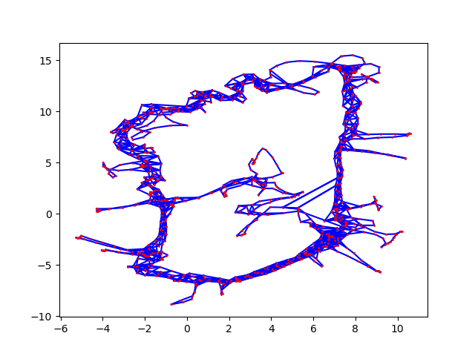
Experiment 2: How does Huber kernel react on poor initial estimates?
Huber Kernel Output (2.5 variance)
No Kernel Output (2.5 variance)
Notes:
Robust Kernel vs No Kernel (initial estimates)

Slide 10
Experiment 3: How do robust kernels react differently on close loop constraint outliers?
Notes:
Loop Closure

Slide 11
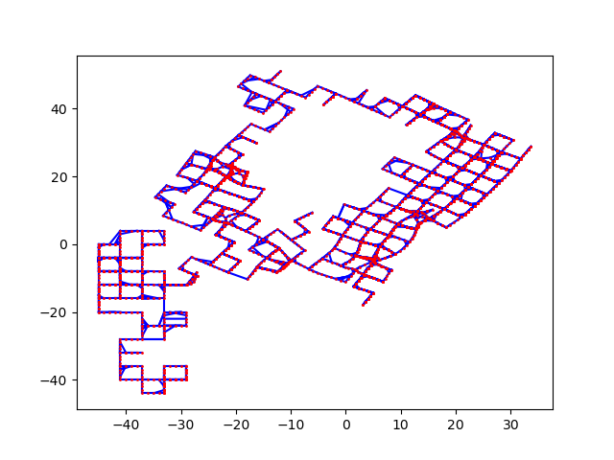
Experiment 3: How do robust kernels react differently on close loop constraint outliers?
Ground Truth
Optimized with 10 Incorrect Loop Closures
Notes:
Loop Closure
https://nikosuenderhauf.github.io/assets/papers/ICRA12-robustSLAM.pdf:
So called robust cost functions, like the Huber function [12], can reduce the influence of potential outliers. The idea of Huber is that the error function for data points whose error is above a certain threshold (also called the kernel width) should raise linearly instead of quadratically as is normally the case in least squares. This behaviour can be added easily to existing least squares solvers and is for instance optionally available in g2o [18]. However, robust cost functions are not sufficient to deal with outlier constraints like false-positive loop closures since the influence of outliers is merely reduced, but not removed. This however can still lead to defective solutions,as we see in Fig. 3(b) where a Huber function with kernel width 0.1 was used.

Slide 12
Summary
Gauss Newton may converge faster, but LM and DL are more stable
Robust kernels help against poor initialization
Geman, Huber, DCS
Common kernels not very effective against loop closure outliers
Future Work
Perform more experiments on different datasets
Implement kernel robust against false positive loop closures

Slide 13
Questions?

